Slide 1
DETERMINATION OF PHYSICAL PROPERTIES FROM M.D SIMULATIONS USING FROM METHANOL-WATER MIXTURE.
By TOLUWALASHE OMOTUNDE

Slide 2
Table of content
Why study water-alcohol mixtures
Background Information
Relating to physical properties
Procedure
Result and Discussion
Future work

Slide 3
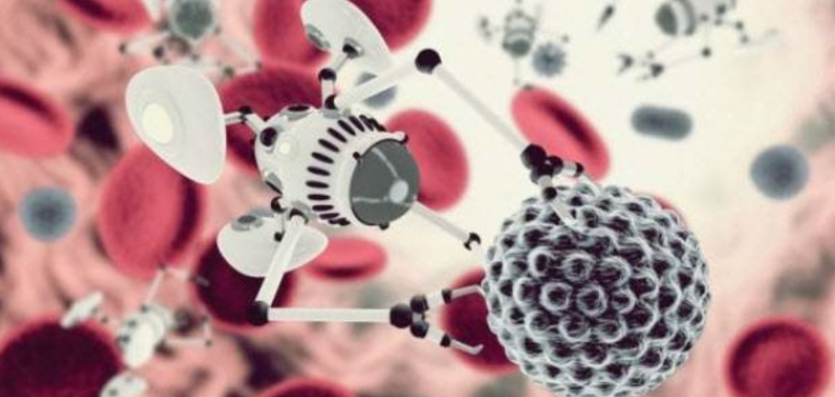
WHY STUDY WATER-ALCOHOL MIXTURES
Water-Alcohol mixtures are widely used in chemical engineering applications such as solvents for gums, resins, lacquers, varnishes and dyes. Modeling and quality control of industrial manufacturing processes require proper characterization of viscosity.

Slide 4
BACKGROUND INTRODUCTION?
WHY MOLECULAR DYNAMICS?
Can observe how atoms move in space and time.
We can determine properties of unknown and known chemicals under extreme conditions of temperature or pressure.

Slide 5
BACKGROUND INFORMATION
WHAT is MOLECULAR DYNAMICS?
Way of determining trajectories of atoms and molecules by numerically solving Newton’s equation of motion for a system of interacting particles.
Where forces between the particles and their potential energies are often calculated using interatomic potentials or molecular mechanics force fields.

Slide 6
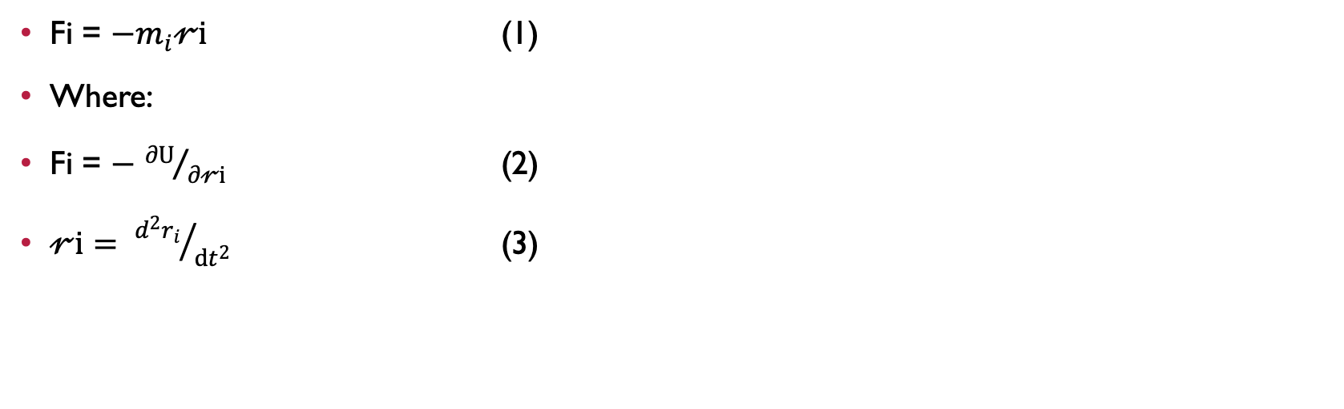
HOW IT WORKS
Fi = −$m_{i}𝓇i$ (1)
Where:
Fi = − ${∂U}/{∂𝓇i }$ (2)
$𝓇i= {d^{2}r_{i}}/{dt^{2} }$ (3)

Slide 7
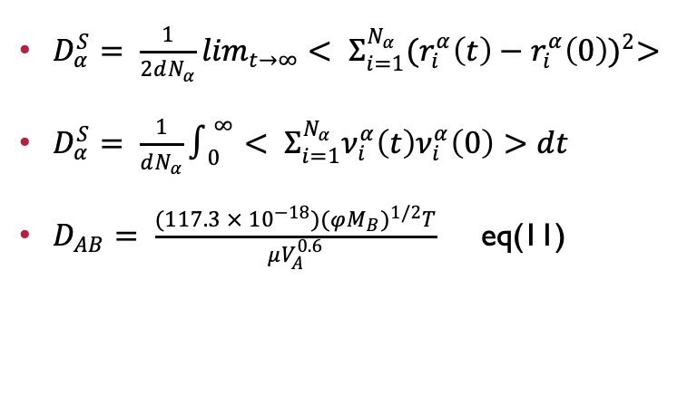
Relationship to physical properties
$D_{α}^{S}= \frac{1}{2dN_{α}}\lim_{t→∞}< Σ_{i=1}^{N_{α}}{(r_{i}^{α}\left(t\right)−r_{i}^{α}\left(0\right))}^{2}>$
$D_{α}^{S}= \frac{1}{dN_{α}}∫_{0}^{∞}< Σ_{i=1}^{N_{α}}ν_{i}^{α}\left(t\right)ν_{i}^{α}\left(0\right)>dt$
$D_{AB}= \frac{(117.3 × {10}^{−18}){(φM_{B})}^{1/2}T}{μV_{A}^{0.6}}$ eq(11)
Calculation of self-diffusion coefficient involves taking the slope of the mean square displacement (MSD) at a long period using Einstein’s equation.
Can also calculate by evaluating integral of velocity autocorrelation function using Green-Kubo equations

Slide 8
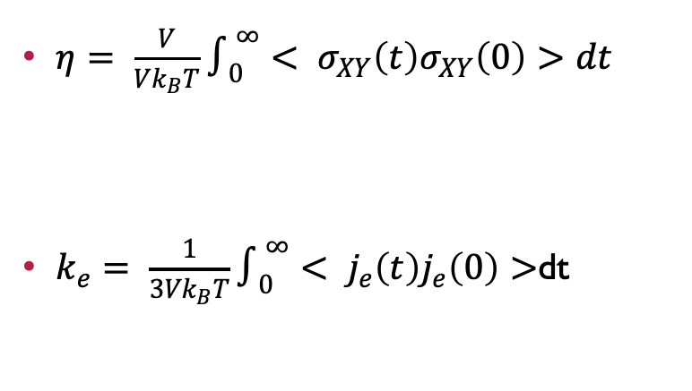
Relationship to physical properties
$η= \frac{V}{Vk_{B}T}∫_{0}^{∞}< σ_{XY}\left(t\right)σ_{XY}\left(0\right)>dt$
$k_{e}= \frac{1}{{3Vk}_{B}T}∫_{0}^{∞}< j_{e}\left(t\right)j_{e}\left(0\right)>$dt
Shear viscosity
Electrical Conductivity

Slide 9
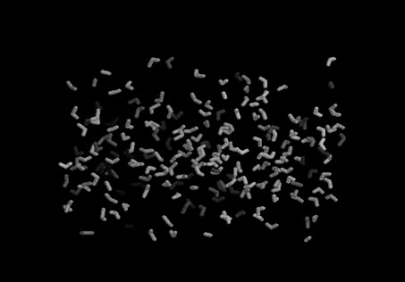
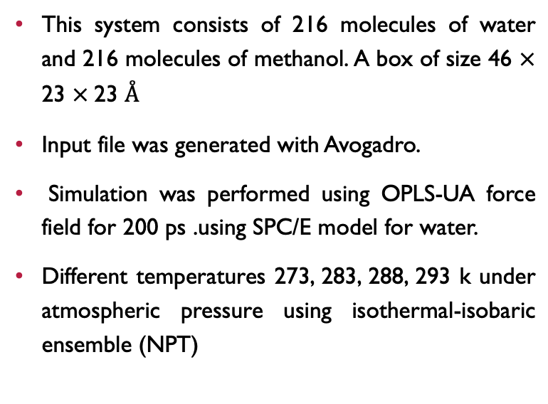
PROCEDURE
This system consists of 216 molecules of water and 216 molecules of methanol. A box of size 46 $×$ 23 $×$23 $Å$
Input file was generated with Avogadro.
Simulation was performed using OPLS-UA force field for 200 ps .using SPC/E model for water.
Different temperatures 273, 283, 288, 293 k under atmospheric pressure using isothermal-isobaric ensemble (NPT)

Slide 10
RESULT
Temperature (K) | Diffusion coefficient by MD (cm²/s) | Diffusion coefficient by Eq. 11 (cm²/s) | Experimental value [11]
273 | 1.22 * 10⁻⁵ | 0.98 * 10⁻⁵ | -
283 | 1.62 * 10⁻⁵ | 1.18* 10⁻⁵ | -
288 | 1.81*10⁻⁵ | 1.42* 10⁻⁵ | 1.56 * 10⁻⁵
293 | 2.01*10⁻⁵ | 1.60* 10⁻⁵ | 1.80 *10⁻⁵

Slide 11
RESULTS
Temperature (K) | Calc. Density (kg/m^3) | Exp. Density (kg/m^3) [11] | Error %
273 | 934.10 | 928.70 | 0.0057
283 | 927.27 | 922.10 | 0.0056
288 | 915.26 | 918.50 | 0.0037
293 | 916.54 | 915.60 | 0.0008

Slide 12
RESULTS
Temperature | 273 K | 283 K | 288 K | 293 K
MD Calculated value | 1.27 | 1.07 | 0.95 | 0.71
Experimental value [13] | 1.06 | 0.9 | 0.85 | 0.74
Error % | 17.8 | 14.3 | 8.6 | 4.23
293 |  | 916.54 | 915.60 | 0.0008

Slide 13
FUTURE WORK
Study how the mixture interacts under confinement and in porous media
Simulate the water+emulsions

